Slide 1
Deep Learning Approach For Detecting Deforestation And Predicting Highly
Threatened Areas
A.I.Hewarathna - 17APC3081
Supervisor: Mr P. Vigneshwaran,
Lecturer(Probationary)
Department of Software Engineering,
Faculty of Computing
Co-Supervisor: Mr J. Charles,
Lecturer (Probationary) in Computer Science
Dept. of Physical Sciences and Technology,
Faculty of Applied Sciences

Slide 2
Content
Background
Literature Review
Research Gap
Problem Statement & Research Questions
Research Objectives & Goals
Proposed Research Method/s
Expected Outcome/s
References

Slide 3
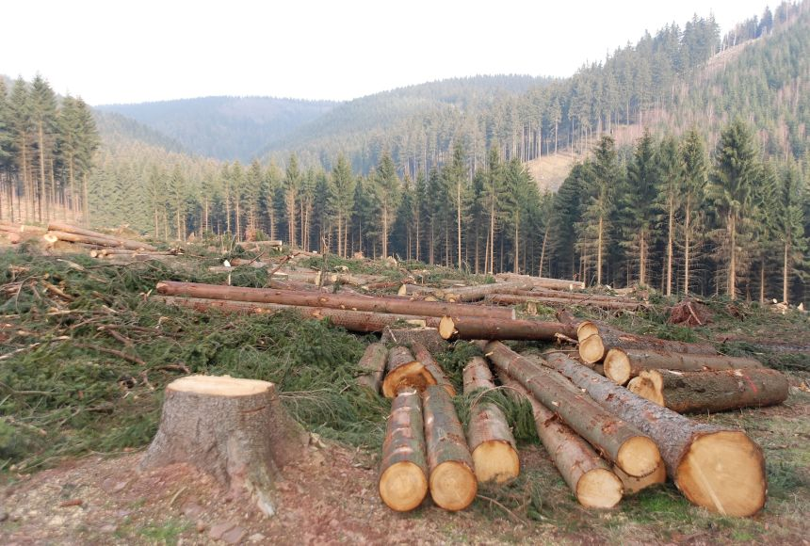
Background
Deforestation is the permanent removal or destruction of forests or woodland regions, generally for agriculture, urbanization, logging, or the extraction of natural resources.

Slide 4
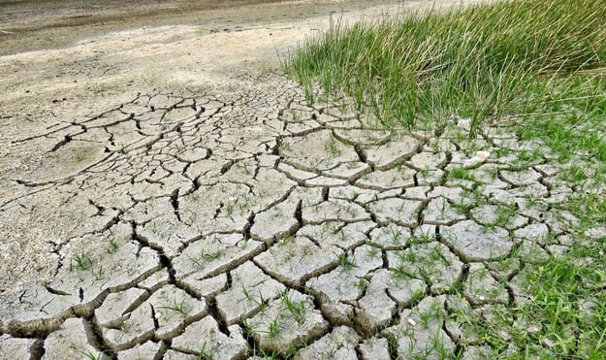
Impacts of Deforestation
Biodiversity loss and degradation of habitats.
Contribution to climate change through increased greenhouse gas emissions.
Disruption of ecosystem services.
Negative effects on local populations and indigenous peoples.

Slide 5
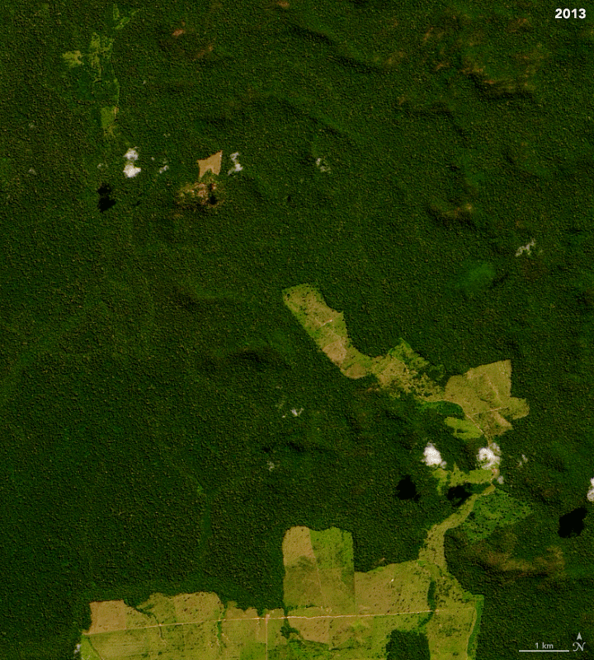
Importance of Monitoring Forest Cover
Determine the extent of habitat loss and fragmentation.
Identify areas of high biodiversity value requiring conservation attention.
Understand the impact of deforestation on ecosystem services.
Make informed decisions about sustainable land use planning and natural resource management.

Slide 6
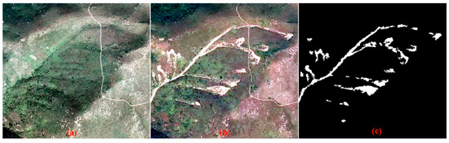
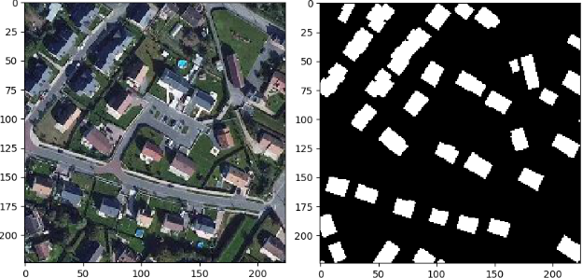
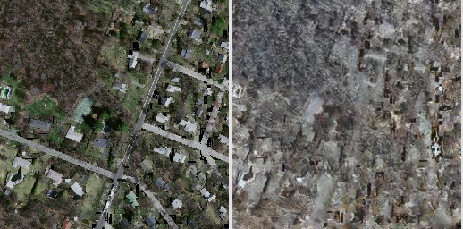
Literature Review
Input data
Bi-temporal
Single image
Single image dataset with inpainting to apply changes

Slide 7
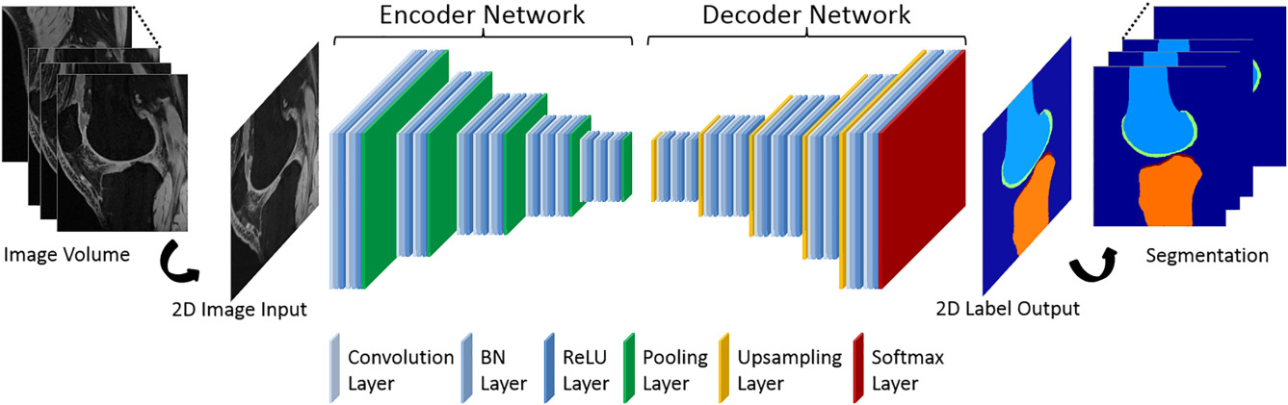
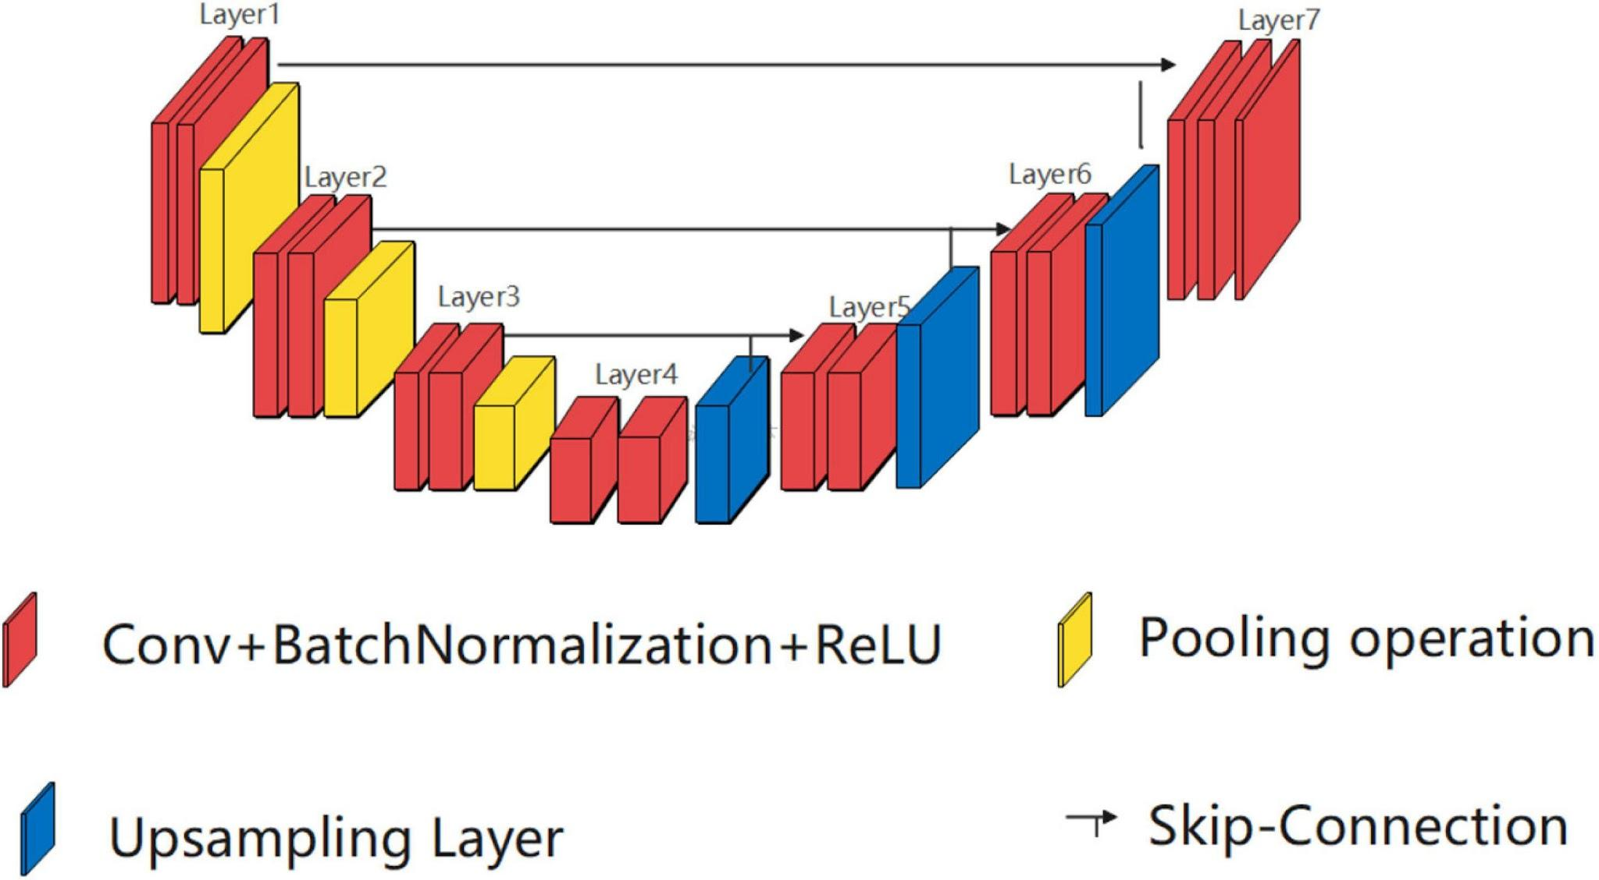
Architecture
Encoder-decoder architecture
Attention based u-net
Focus u-net with shorter skip connections
Two step fusion to gain ultra-high precision
Densely connected attention U-Net
Adaptive Enhanced Swin Transformer with U-Net
Transformer-based decoder

Slide 8
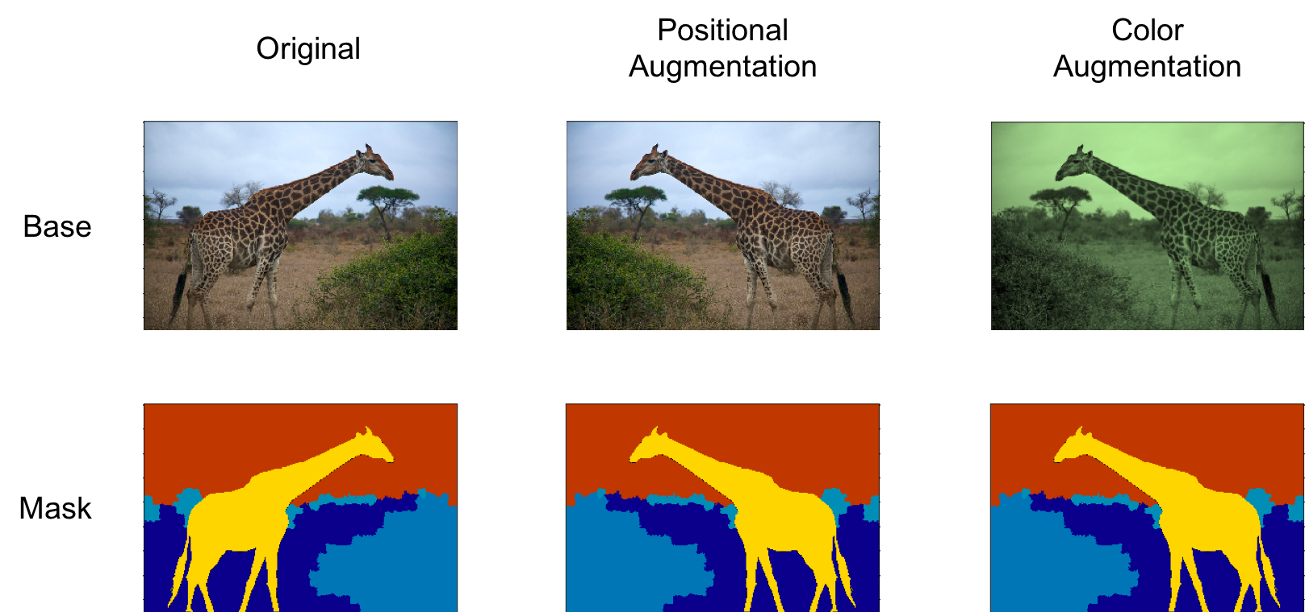
Other noticeable works
Merge of pixel-level and object-level segmentation
Localize the tracking
Augmentation techniques to improve satellite imagery datasets

Slide 9
Research Gap
Lack of essential temporal resolution, spatial coverage, or ground truth labels in existing datasets.
Need for comprehensive datasets representing various aspects of forest cover changes at multiple sizes and time intervals.
Research gap in investigating the applicability of attention-based U-Net architectures for detecting changes in forest cover.
Lack of comparison studies evaluating different U-Net architectures, including attention and focus-based processes, and lightweight models.
Acquiring or curating high-quality satellite image datasets.
Investigating attention-based U-Net architectures with sequential images.

Slide 10
Problem Statement & Research Questions
Problem Statement
Detecting deforestation and tracking forest cover reduction using deep learning segmentation approaches, with a focus on forecasting highly vulnerable areas of the forest that are prone to deforestation. The study intends to compare the performance of semantic segmentation methods based on the U-Net architecture, maybe with modifications, using a freshly developed benchmark satellite image dataset.

Slide 11
Research Questions
RQ1: how to collect sequential satellite images?
RQ2: what are the modified U-Net architectures that can use in this study?
RQ3: how to predict highly threatened areas of forest to deforestation?
RQ4: how the model evaluation should do?

Slide 12
Research Objectives & Goals
To provide guidelines and best practices for collecting sequential satellite images suitable for forest cover change detection and deforestation identification.
To propose modified U-Net architectures that leverage attention or focus-based mechanisms to improve the model's ability to capture relevant spatial and temporal features.
To develop accurate and reliable predictive models that can identify highly threatened areas of the forest prone to deforestation.
To establish a comprehensive model evaluation framework that enables objective assessment and comparison of different modified U-Net architectures in predicting highly threatened areas of the forest.

Slide 13
Proposed Research Method/s
Data Collection
Google Earth's historical image function will be utilized to create a sequential image dataset for the study.
Image pre-processing activities will be conducted to ensure data quality and consistency, including color correction and image augmentation techniques.
Ground truth labels or masks indicating deforested areas will be created using methods such as hand annotation, existing deforestation maps, and remote sensing techniques.
Additional pre-processing procedures may be undertaken to normalize the picture data, address data imbalance, and apply spatial transformations for effective training of segmentation models.

Slide 14
Methodology
Pre-processing steps: Satellite images are pre-processed to improve their quality and usability for study.
The pre-processed photos are separated into sets for training, validation, and testing.
Model construction: Using the training set, models based on modified U-Net architectures are developed.
Evaluation of performance: The performance of each model is evaluated using selected metrics such as accuracy, precision, recall, or F1 score.
Model comparison: The performance of various models is evaluated in order to determine the most effective architecture.

Slide 15
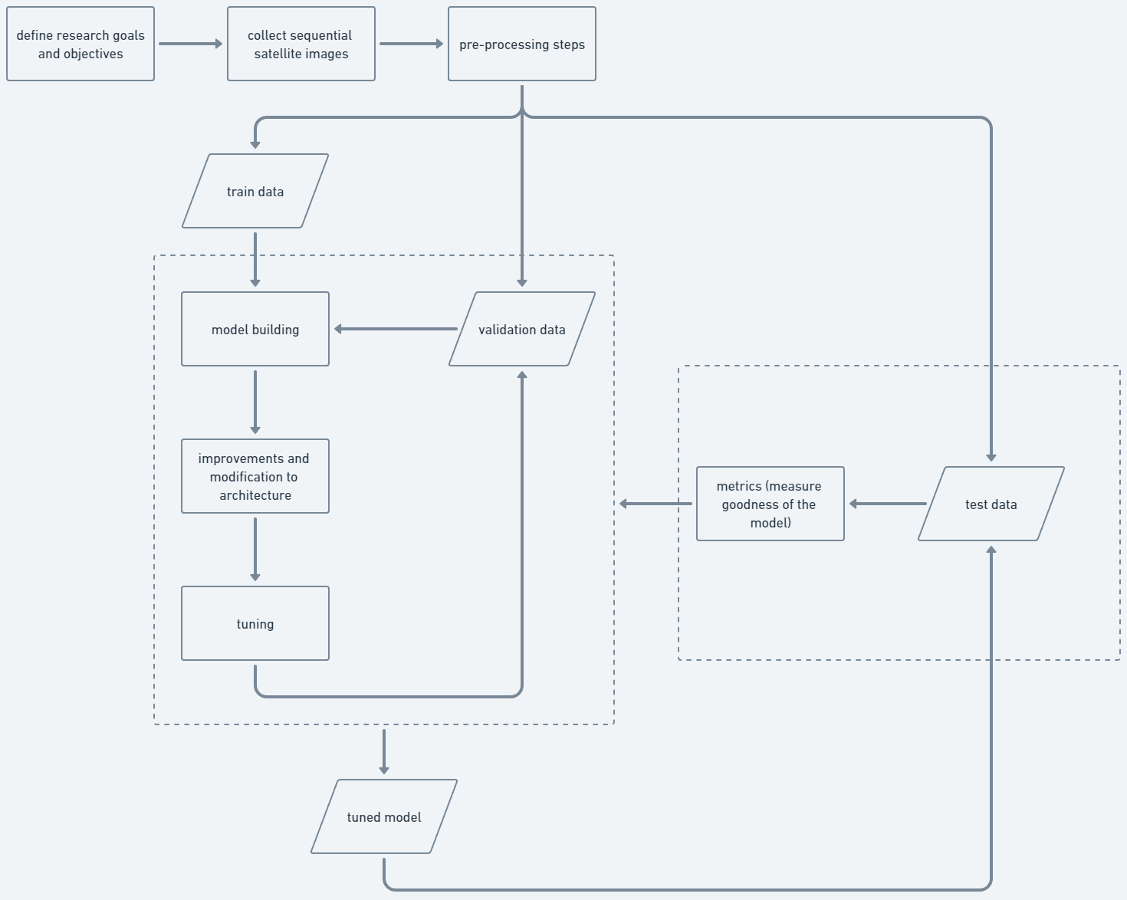

Slide 16
Expected Outcome/s
Develop predictive algorithms to accurately identify endangered forest zones at risk of destruction.
Train and refine deep learning models using modified U-Net architectures to analyze satellite images and identify deforestation-prone areas.
Perform comparative analyses of modified U-Net designs
Propose improved U-Net topologies incorporating attention or focus-based techniques.
Generate a new dataset.
Improve the identification of highly vulnerable forest regions.

Slide 17
References
Y. Chen, X. Ouyang, and G. Agam, "ChangeNet: Learning to Detect Changes in Satellite Images," presented at the Proceedings of the 3rd ACM SIGSPATIAL International Workshop on AI for Geographic Knowledge Discovery, Chicago, IL, USA, 2019. [Online]. Available: https://doi.org/10.1145/3356471.3365232.
L. Fahad and R. Yassine, "Survey on semantic segmentation using deep learning techniques," Neurocomputing, vol. 338, pp. 321-348, 2019, doi: https://doi.org/10.1016/j.neucom.2019.02.003.
Y. He, K. Jia, and Z. Wei, "Improvements in Forest Segmentation Accuracy Using a New Deep Learning Architecture and Data Augmentation Technique," Remote Sensing, vol. 15, no. 9, p. 2412, 2023. [Online]. Available: https://www.mdpi.com/2072-4292/15/9/2412.
L. Xu, W. Jing, H. Song, and G. Chen, "High-Resolution Remote Sensing Image Change Detection Combined With Pixel-Level and Object-Level," IEEE Access, vol. 7, pp. 78909-78918, 2019, doi: 10.1109/ACCESS.2019.2922839.
Z. Shuangpeng, F. Tao, and H. Hong, "Farmland Recognition of High Resolution Multispectral Remote Sensing Imagery using Deep Learning Semantic Segmentation Method," presented at the Proceedings of the 2019 the International Conference on Pattern Recognition and Artificial Intelligence, Wenzhou, China, 2019. [Online]. Available: https://doi.org/10.1145/3357777.3357788.
V. Sainte Fare Garnot and L. Landrieu, "Panoptic Segmentation of Satellite Image Time Series with Convolutional Temporal Attention Networks," 07 2021.

